Slide 1
Attendance

Slide 2
Computer Organisation
Topic 4
Digital Logic (Part 2)
Stallings, Computer Organization & Architecture (9th Ed.), Chap. 11
Notes:
2

Slide 3
Outline
Sequential Circuits
Flip-Flops
Registers
Counters
Programmable Logic Devices
Programmable Logic Array
Field-Programmable Gate Array

Slide 4
Introduction
Combinational circuits
Implement functions of a computer
Outputs depend entirely on the present input
No memory (except for ROM)
Notes:
Combinational circuit contain a combination of AND gates or OR gates to implement functions of a computer.
For this type of circuit, the outputs depends solely on the value of the input …so whatever value you input to ABC or XYZ, that is basically will determine the value of F
In combinational circuit, there is not capability to store values or no memory capabilities expect for ROM.
But ROM is a special case for combinational circuit because the functions is basically fuse onto the chips…or the value of the function is already determined by how it is connected to the various gates

Slide 5
Introduction
Storage elements
Devices that are capable of storing binary information (which defines the state of the sequential circuit)
Notes:
In order to have some storage elements, we need to have devices that are capable of storing binary information depending on the state of the sequential circuit that depends on the inputs, depending on the timing and also depending on the previous state of circuit

Slide 6
Sequential Circuit
Current output depends on the current input and the current state of the circuit
Consists of a combinational circuit to which storage elements are connected to form a feedback path
Notes:
So that is why we need the sequential circuit
Because in sequential circuit, the current output depends on the current input and the current state of the circuit…this happens thru a combination of circuit as well, but the storage elements are connected in a form of feedback path…
It means whatever is potentially the output, can be channeled back to the input in the circuit and this condition helps to monitor the state of the circuit

Slide 7
Flip-Flops
Simplest sequential circuit
It has the capability to “store” information (1-bit memory)
Notes:
One of the example of sequential circuit is the flip flop…the reason why it was called flip flop because the value of output can flip from 0 to 1 and 1 to 0.
This is the simplest form of sequential circuit and it has the capability to store information and this case, the flip flop can store 1 bit memory
It means 1 flip flop is to store 1 bit of memory or to store 1 bit binary value

Slide 8
Flip-Flops
A bistable device
Exists in one of two states
In the absence of the input remains in that state
With two outputs, Q & Q, which are the complement of each other
Notes:
Basically flip flop is a bistable device meaning it can exists in one of two states
Means it can be in a value of 1 or it can be in a value of 0
If there is no input is given to this device, the device will remain in its current state
In order to facilitate the output, the flip flop will contain 2 outputs, the output will be Q and the complement of Q, NOT Q. So flip flop will always have 2 outputs, one is Q and another one is its complement

Slide 9
Flip-Flops
Input
Combinational Circuit
Output
Flip-Flops
(memory)
Clock
Notes:
This is roughly how the flip flop can be organized.
Flip flop will potentially store a memory values, either 1 or 0, but where does it get its input from?
It can come from combinational circuits, that means other circuit that trying to express the function and that function has the output F, and the F can be the input to flip flop in order to store output of the function
But often the flip flop is synchronized with the computers clock, so the flip flop can change depending on the value of clock whether is it 1 or 0.

Slide 10
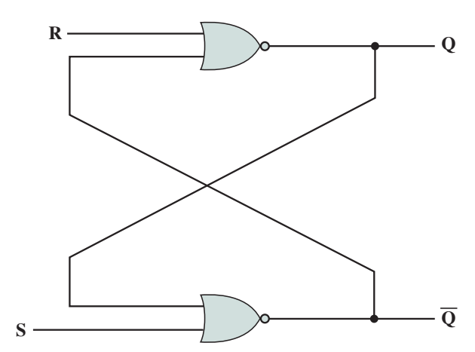
S-R Latch
Reset = 0
2 inputs
S (Set) and R (Reset)
2 outputs
Q and Q
2 NOR gates connected in a feedback manner
Set = 1
Notes:
One of the implementation of flip flop is in the form of S-R latch.
In this case, set means to make it value 1 and reset is to make it value 0
If the S is set to 1, it will then make the output as 1
If R input is 1, the reset will then make the output value as 0 (because the purpose of R is to reset the output value to 0)
If you notice how the S-R latch is organized….the output of R will be then feedback to S as an input and the output of S will be then feedback to R as an input

Slide 11
S-R Latch
0
0
1
S =0, R=0, Q=0
Inputs to lower NOR gate are Q=0, S=0
0
1
0
Flip-flops remains stable in this state
Notes:
If you notice, the input Q = 0 is feedback to the S input
Then, the NOT Q value is then channel to input R

Slide 12
S-R Latch
0
1
0
S =0, R=0, Q=1
Inputs to lower NOR gate are Q=1, S=0
1
0
0
Flip-flops remains stable in this state
Notes:
If you notice, the input Q = 0 is feedback to the S input
Then, the NOT Q value is then channel to input R

Slide 13
Setting the S-R Latch

Slide 14
S-R Latch
Let’s say initially
S=0, R=0, Q=0, Q=1
0
0
1
0
1
0
Then S=1
Inputs to lower NOR gate are S=1, Q=0
After Δt, output of lower NOR gate will be Q=0
Inputs to the upper NOR gate become R=0, Q=0
After another Δt,
output Q=1
1
0
0
1
1
0
1
Notes:
Okay, this is the initial state of SR latch where S, R, Q is 0 and NOT Q is 1.
Next, we want to set the flip flop where the setting requires S value to be a 1, so we hope that the Q value will change from 0 to a 1.
When S is 1, that means we are setting the flip flop, when we set the flip flop, it means we want to change the Q from 0 to 1.
S = 1
Q value 0 is now feedback to S NOR gate, and 0 and 1 is 1, and the NOT will make the NOT Q become 0
The NOT Q value will be then feedback to R gate

Slide 15
S-R Latch
After that, if S=0
Inputs to lower NOR gate are S=0, Q=1
After Δt, output of lower NOR gate will be Q=0
Inputs to the upper NOR gate become R=0, Q=0
After another Δt,
output Q=1
0
1
0
0
1
Notes:
From the previous example, setting the S to 1 will make Q to become a 1.
So now what will happen if S is now 0? In this case, we are not setting the flip flop, we just changing the S to become a 0
Look at the diagram, S is 1 and Q was made to become 1 and the SR latch is in stable condition.
If you notice, by changing the S value to 0, the status of Q and NOT Q do not change (it maintain).

Slide 16
Reset the S-R Latch

Slide 17
S-R Latch
Initially S=0, R=0, Q=1, Q=0
1
0
1
0
1
0
R=1
1
Inputs to upper NOR gate are R=1, Q=0
After Δt, output of upper NOR gate will be Q=0
Inputs to the lower NOR gate become S=0, Q=0
After another Δt,
output Q=1
After that, if R=0
Q=0, Q=1
0
1
0
1
0
0
Notes:
When R is now 1, we are trying to reset the SR Latch, the purpose of resetting is to make Q value from 1 to 0.

Slide 18
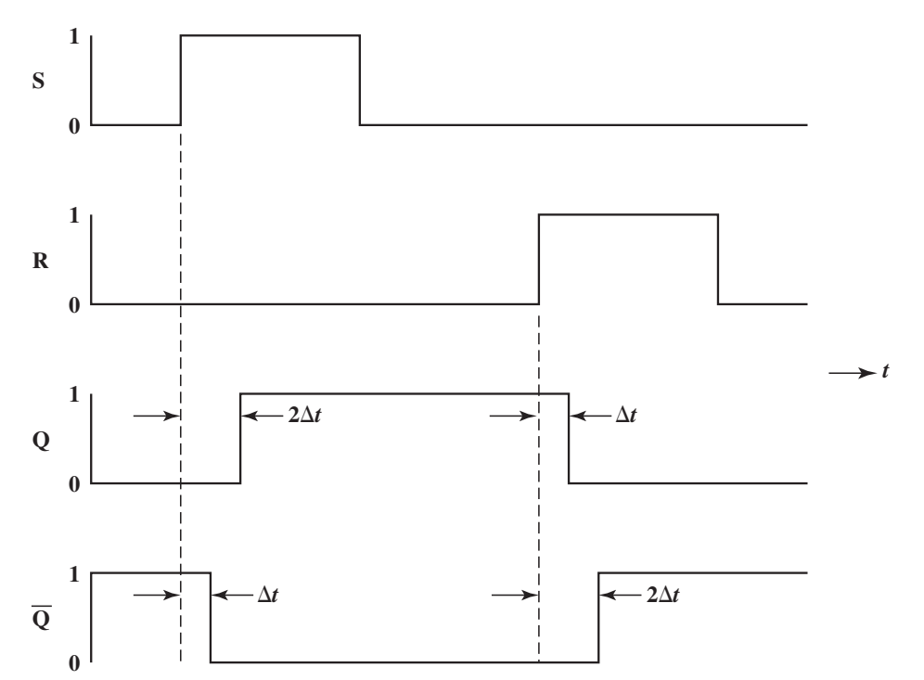
S-R Latch
NOR S–R Latch Timing Diagram
Notes:
This is a diagram that show the behaviour of input S and R and how it affect the output Q and NOT Q.
Okay, when you want to do a setting, when S is change from 0 to a 1, the NOT Q changes first, the NOT Q will change to a 0 then only followed by Q becoming a 1.
In the case of resetting, when you change a R to a 1, which mean you wan to reset the SR Latch, where you want Q to become a 0…
The behaviour of resetting where Q will be changed to a 0 first, then only followed by NOT Q.

Slide 19
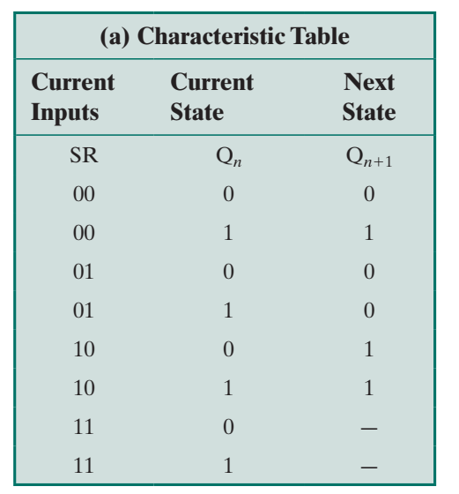
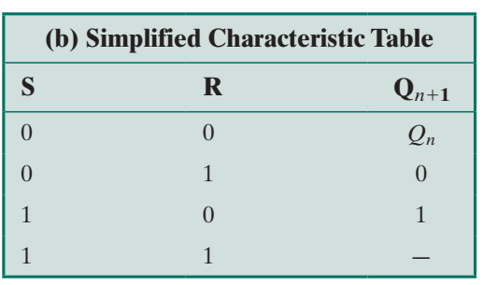
S-R Latch
Summary
S writes a 1 to Q
R writes a 0 to Q
S=1 and R=1 at the same time are not allowed
Inconsistent output

Slide 20
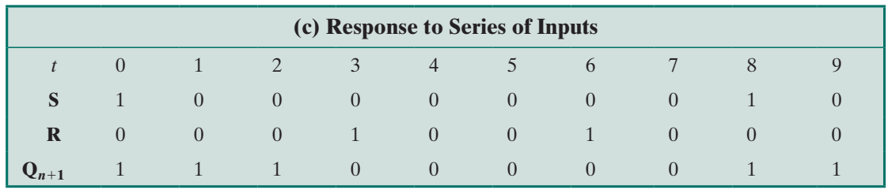
S-R Latch
Notes:
If S value changed from 1 to 0, the Q value is maintain
If R value is change to 1, (resetting condition), you the Q value changed to 0.

Slide 21
Clocked S-R Flip-Flop
S-R latch
Output changes in response to a change in input
Brief time delay
Asynchronous
Notes:
Another example or another implementation of flip flop is the clocked SR flip flop.
In the normal SR Latch, the output changes depending on how the input changes
There will be usually delay or some non-scynronocity between the flip flop. That means it changes when there is a change.

Slide 22
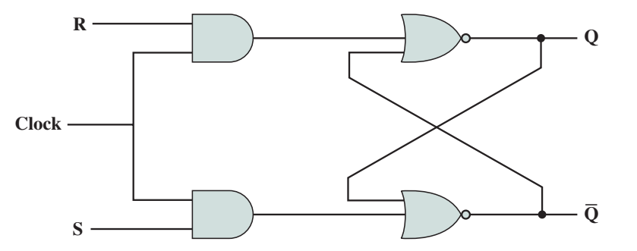
Clocked S-R Flip-Flop
Events in digital computer are synchronised according to clock pulse
Clocked S-R flip-flop
Notes:
But if you want to be something organized, especially in the computer, for example you want a signal to propagate in timely manner, we need to synchronize the changes of the output and input at the same time.
So in this case, we attached a clock to R and S input, it means S and R can only be in affect if the clock changes from 0 to a 1.
So, when the clock is a 1, then only whatever value of R is allowed, and when the clock is a 1, then only whatever value of S is allowed too because both are connected to an AND gate
With the clock input, it makes sure the value of S and R are changed at a fixed time or predictable time and that is why it is called scynchronous.
If you notice, after the RS being synchronise by the clock, it will then go through the SR NOT gate

Slide 23
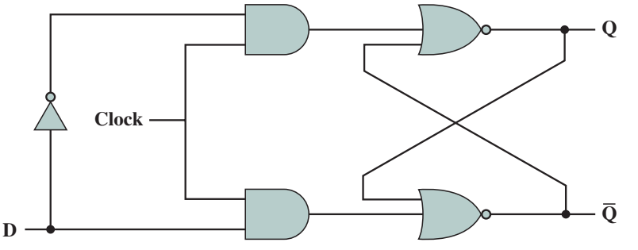
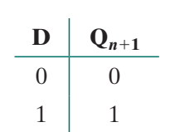
D Flip-Flop
A single input ensures that S=R=1 never occurs
Inverter ensures (non-clock) inputs to the AND gates are opposite
Also called data flip-flop
Reset
Set
Notes:
The next example of SR latch implementation is D flip flop.
For D flip flop case, it make sure S and R value will never be 1 at the same time.
This can be achieved my inverting the input to make sure that both S and R are always having the opposite value.
If you see in the diagram, the D input will be channeled to the original S AND gate and at the same time, D is inverted and channel to the R AND gate.

Slide 24
J-K Flip-Flop
Similar to S-R flip-flop
All combinations of input values are valid
Notes:
The last type of SR latch is JK flip flop
It is very much similar to SR flip flop but all combination are valid including when the S and R are both 1.

Slide 25
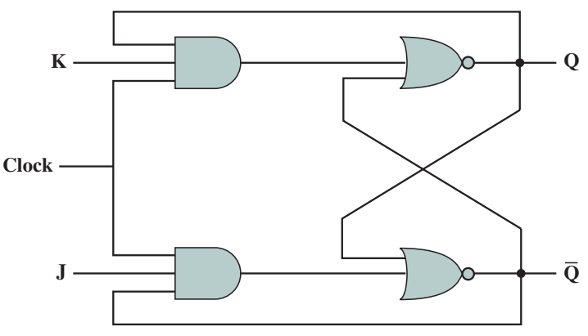
J-K Flip-Flop
When J=K=1 it acts as a toggle function, the output is a reverse of the present state
Notes:
In this case, when J and K is 1 (meaning J=S and K=R) is 1, it will act as a toggle, which mean it reverse the output Q and NOT Q.
SO that means, if originally Q is the 0, it will toggle the Q value to 1.

Slide 26
J-K Flip-Flop
When J=K=1 it acts as a toggle function, the output is a reverse of the present state
0
0
1
0
0
0
1
1
1
1
0
1
1
1
1
0
0
1
0
1
1
1
1
1
1
Notes:
Let’s see how the JK flip flop behave, the toggling of the flip flop
When we toggle, the Q value will change to become a 1
1. We change the value of J and K to 1 to initiate the toggling

Slide 27
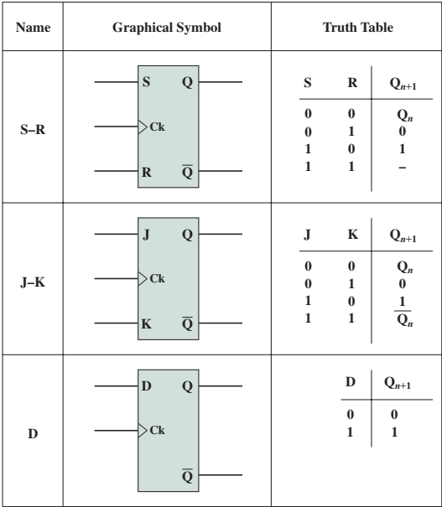
S-R vs. J-K vs. D Flip-Flips
S = to set
R = to reset
S = R =1, not ALLOWED
J = to set
K = to reset
S = R =1, it will toggle the Q value
Input value will be channelled to output

Slide 28
Outline
Sequential Circuits
Flip-Flops
Registers
Counters
Programmable Logic Devices
Programmable Logic Array
Field-Programmable Gate Array

Slide 29
Registers
Digital circuit within CPU to store one or more bits of data
Two types:
Parallel registers
Shift registers
Notes:
Remember that register is the memory that is closest to the CPU and it stores one or more bits of data

Slide 30
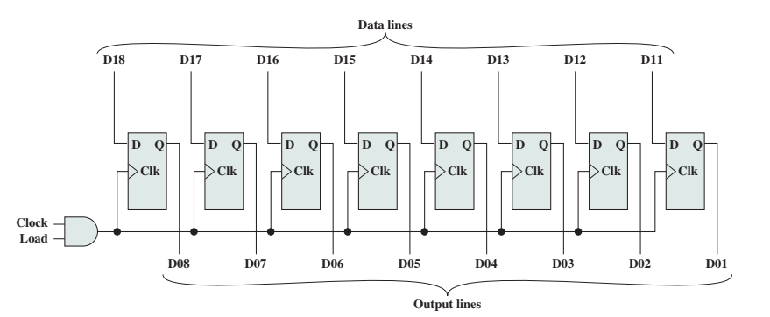
Parallel Registers
Supports simultaneous reading or writing to a set of 1-bit memories
Uses D flip-flops
Notes:
For the parallel registers, as its name implies, it supports simultaneous reading or writing, it means if you have a group of registers, all of them will read or write simultaneously.
To implement parallel registers, we use D flip flops…remember from the previous lecture, D flip flop basically copy the input to the output
If the D input is a 1, the output will be a 1
Based on this example in the slide, you have 8-bit register, and the data lines is on the top….so whatever value you feed to data line, it will be then be fed simultaneously to all the registers

Slide 31
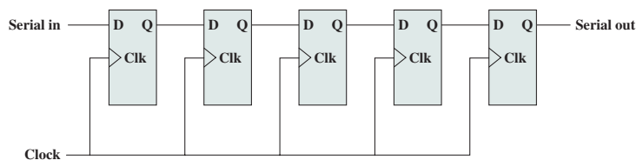
Shift Registers
Accepts/transfers information serially
Use (clocked) D flip-flops (or even S-R)
Input only to left-most flip-flop
Data are shifted one position at every clock pulse
Use to interface to serial I/O devices, perform logical shift/rotate functions (ALU), etc.
Notes:
The other kind of register is what we called shift registers.
It basically accepts and then transfer the input serially to the next flip flop
The diagram in this slide is basically the shift right register, that means we are shifting to the right.
The value that we want to shift in at the most left register, will be shifted in at the D input, but the original value of D flip flop is then channel to the righter flip flop
SO the output of the left flip flop will be then channeled to the input D of the righter flip flop
If you recall the implementation of Booth Algorithm, this is exactly what is happening in the register

Slide 32
Counters
Register which increment its value by modulo of its capacity
n flip-flop has the capacity up to 2^{n} – 1
Beyond maximum, is set to 0
E.g. CPU’s program counter
4 flip flops = 2⁴ – 1 = 15 counters
Notes:
Another implementation is the counter.
Flip flop can be used as a counter
In this case, the register is incremented to its value by modulo of its capacity
For example, if you have n flip flops, then you will have the capacity up to 2n-1 in terms of the value
Example – CPU program counter --- it basically increment the value from 0 1 2 3 ……

Slide 33
Ripple Counter
Slow
Output of one flip-flop triggers a change in the next flip-flop (ripple effect)
The counter is incremented at each clock pulse (0000, 0001,0010,0011,…1111, 0000)
Notes:
In terms of counters, there are different types of counter as well.
As it name implies, it start and then it goes outer and outer and outer….
Because of its nature, ripple counter is slow because one flip flop will trigger another flip flop
One is actually waits for the other, so that is why it is considered slow

Slide 34
Ripple Counter
J and K inputs to each flip-flop are held at 1
When there is clock pulse, output Q is inverted (0 to 1, 1 to 0)
Q₀ is least significant bit
Notes:
To implement the ripple counter, we basically use JK Flip flop and this JK Flip flop are always held at 1
If you remember the JK flip flop, when both are 1, they are going to toggle the output value

Slide 35
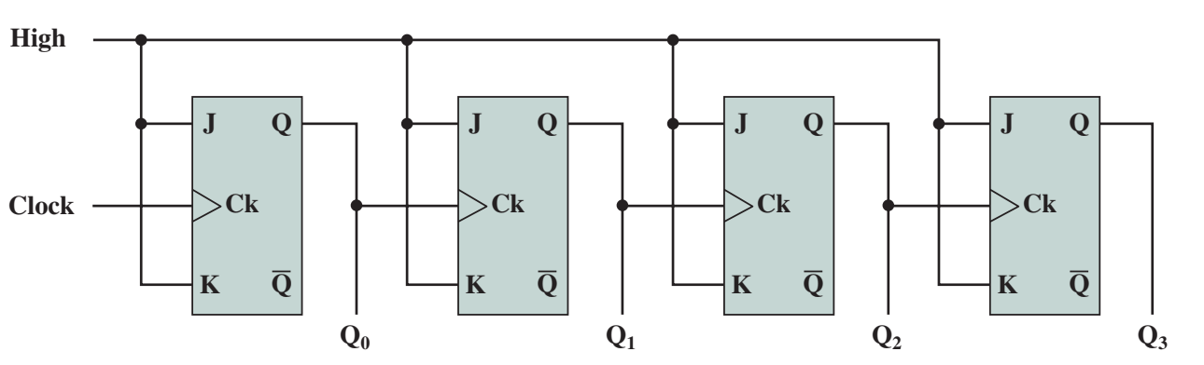
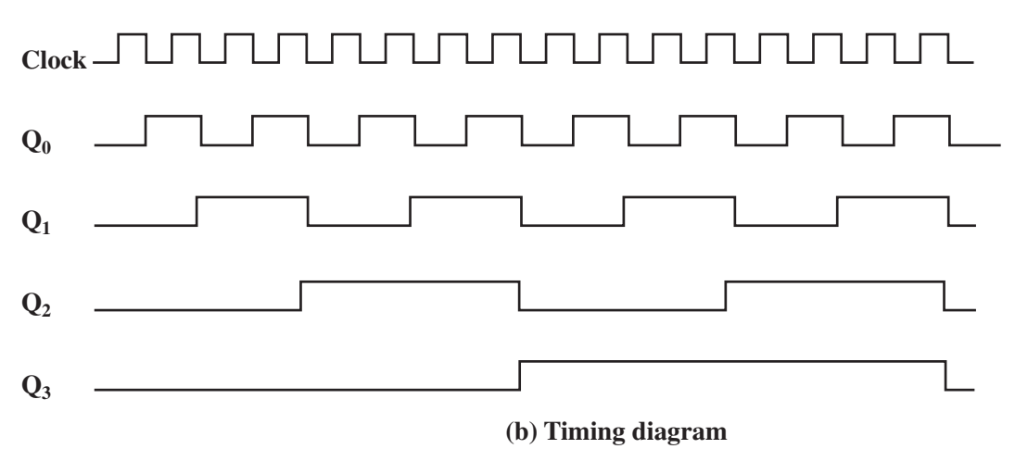
Ripple Counter
Will be toggling most often
When Q0 becomes 0, then only Q1 becomes 1
0
0
1
1
0
1
Notes:
This is the example of implementation of 4 bits ripple counter, if you notice that the input starts from the lefter JK Flip flop
The output of the lefter flip flop will then affect the next flip flop
The left most flip flop is basically the least significant bit, which is the righter bit, this is also will change most often (0 and 1)
When you look at the timing diagram here, when the clock changes, it will change the Q0 most often

Slide 36
Ripple Counter
Q₃ | Q₂ | Q₁ | Q₀
0 | 0 | 0 | 0
0 | 0 | 0 | 1
0 | 0 | 1 | 0
0 | 0 | 1 | 1
0 | 1 | 0 | 0
0 | 1 | 0 | 1
0 | 1 | 1 | 0
0 | 1 | 1 | 1
1 | 0 | 0 | 0
1 | 0 | 0 | 1
1 | 0 | 1 | 0
1 | 0 | 1 | 1
1 | 1 | 0 | 0
1 | 1 | 0 | 1
1 | 1 | 1 | 0
1 | 1 | 1 | 1
Q0 toggle the most often

Slide 37
Synchronous Counter
Faster
All flip-flops change state at the same time
CPUs use synchronous counters
E.g. 3-bit counter using J-K flip-flop
3 flip-flops (A, B, and C – A is least significant bit)
Construct truth table
Notes:
The other implementations of counter will be the synchronous counter
If you recall, the ripple counter depends on the earlier flip flop to trigger the next flip flop, so it is considered in terms of the implementation
Alternatively, the faster way to implement it is using the synchronous counter
Which means all the flip flop potentially can change at any time depending on the input
The synchronous counter is also implemented using the JK flip flop but we need to see how the truth table behave and based on how the truth table behave, we can plan such the input can be channeled to all the necessary flip flop
In other word, we do not rely on the most left JK flip flop or the LSB to toggle the next flip flop
In synchronous counter, the input is channel to all the flip flops and potentially all can change at a certain time

Slide 38
Synchronous Counter

Slide 39
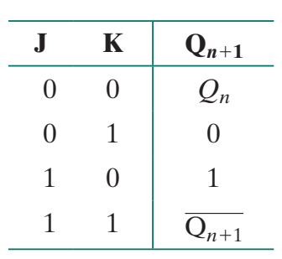
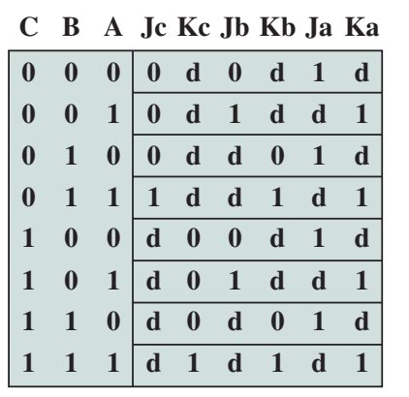
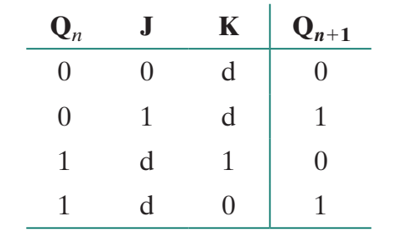
Synchronous Counter
MSB
LSB
S
R
Set & Toggle
Toggle & Reset
Notes:
Ja Ka is the flip flop for A
Jb and Kb is the flip flop for B
Jc and Kc is the flip flop for C
ABC = INPUT
JaKa, JbKb and JcKc = Function

Slide 40
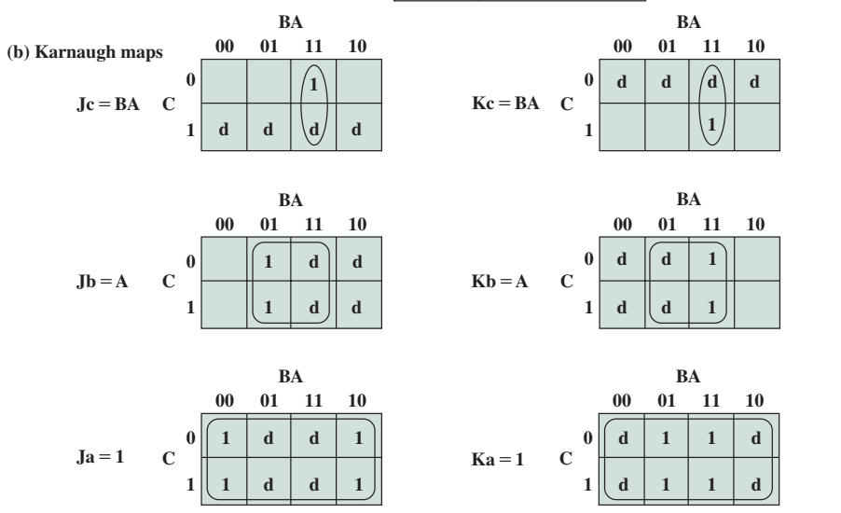
Synchronous Counter
Notes:
How do we implement this synchronous counter?
The truth table from the earliest slide can be simplified using the K-map
The column for JaKa, JbKb and JcKc are separate function, therefore, it needs separate K-map
Based on the truth table, we then plot it to the K-map

Slide 41
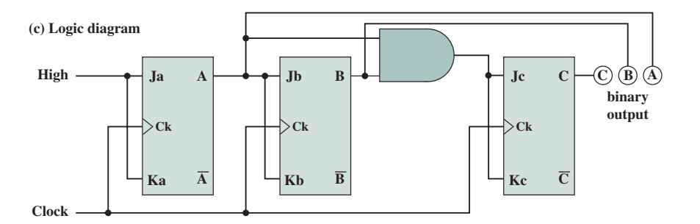
Synchronous Counter
Ja = 1
Ka = 1
Jb = A
Kb = A
Jc = BA
Kc = BA
A flip flop
B flip flop
C flip flop
(1)
Notes:
After you done the simplification, you can then plan the circuit
The simplification for A flip flop will make Ja and ka to receive 1 as an input, so the 1 value is used for A flip flop to toggle between 0 and 1
Then, for B flip flop, it receive the input from A output, therefore, Jb and Kb will receive input from A output from A flip flop
And if you look at C flip flop, it receives input from A output AND B output, that is why we must use the AND gate so that AB can be channeled to C to toggle
If you notice, all flip flops are connected to the clock so that it can change synchronously, which mean, C flip flop does not have to wait for A and B to change and it can potentially change at any time
So, that is basically the concept of Synchronous counter

Slide 42
Outline
Sequential Circuits
Flip-Flops
Registers
Counters
Programmable Logic Devices
Programmable Logic Array
Field-Programmable Gate Array

Slide 43
Programmable Logic Devices
So far, individual gates are building blocks
Any function can be realised
Notes:
Pla is used to help us to implement function that are difficult for us to understand via the truth table
In the first part of this topic, we talk about function, we also talks about the various gates in order to implement those functions
So far, all these individuals' gates are the building blocks and the function can be realized by assembling all these gates

Slide 44
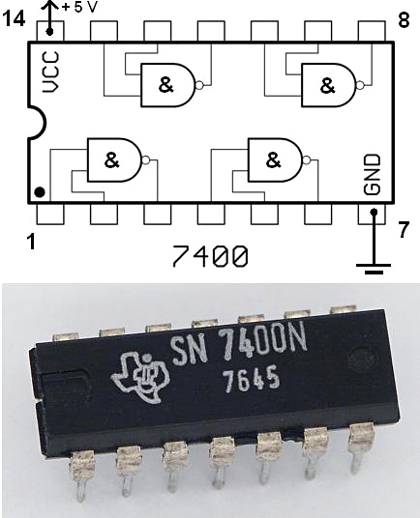
Programmable Logic Devices
Early integrated circuits using SSI provided 1 to 10 gates on a chip
To construct a logic function, a number of these chips are laid out and the appropriate pin interconnections are made
Notes:
And of course assembling a small number of gates are not really efficient and therefore manufacturers they work on the integrated circuit
And that is why they pack a few gates into one device
In the early years of IC, small scall integration that can be up to 10 gates can be packed to a chip

Slide 45
Programmable Logic Devices
Increasing levels of integration made it possible to put more gates on a chip and to make gate interconnections on the chip as well.
Advantages:
Decreased cost and size
Increased speed

Slide 46
Programmable Logic Devices
However,
For each logic function, layout of gates and interconnections must be designed
Cost and time involved for custom chips design is high

Slide 47
Programmable Logic Devices
Thus,
it becomes attractive to develop a general-purpose chip that can be readily adapted to specific purposes
This is the intent of the programmable logic device (PLD)
Notes:
Instead of designing a chip to fulfil certain functions, why not we produce a general purpose chip that can be written into or the function can be written onto the chip easily
Therefore, you don’t have to custom made or custom design a chip
So that is why we have the PLD - which mean all these devices can be programmed
In this case programs means we can make that chip perform certain functions that we want and this functions means F = ABC + A NOT B and C

Slide 48
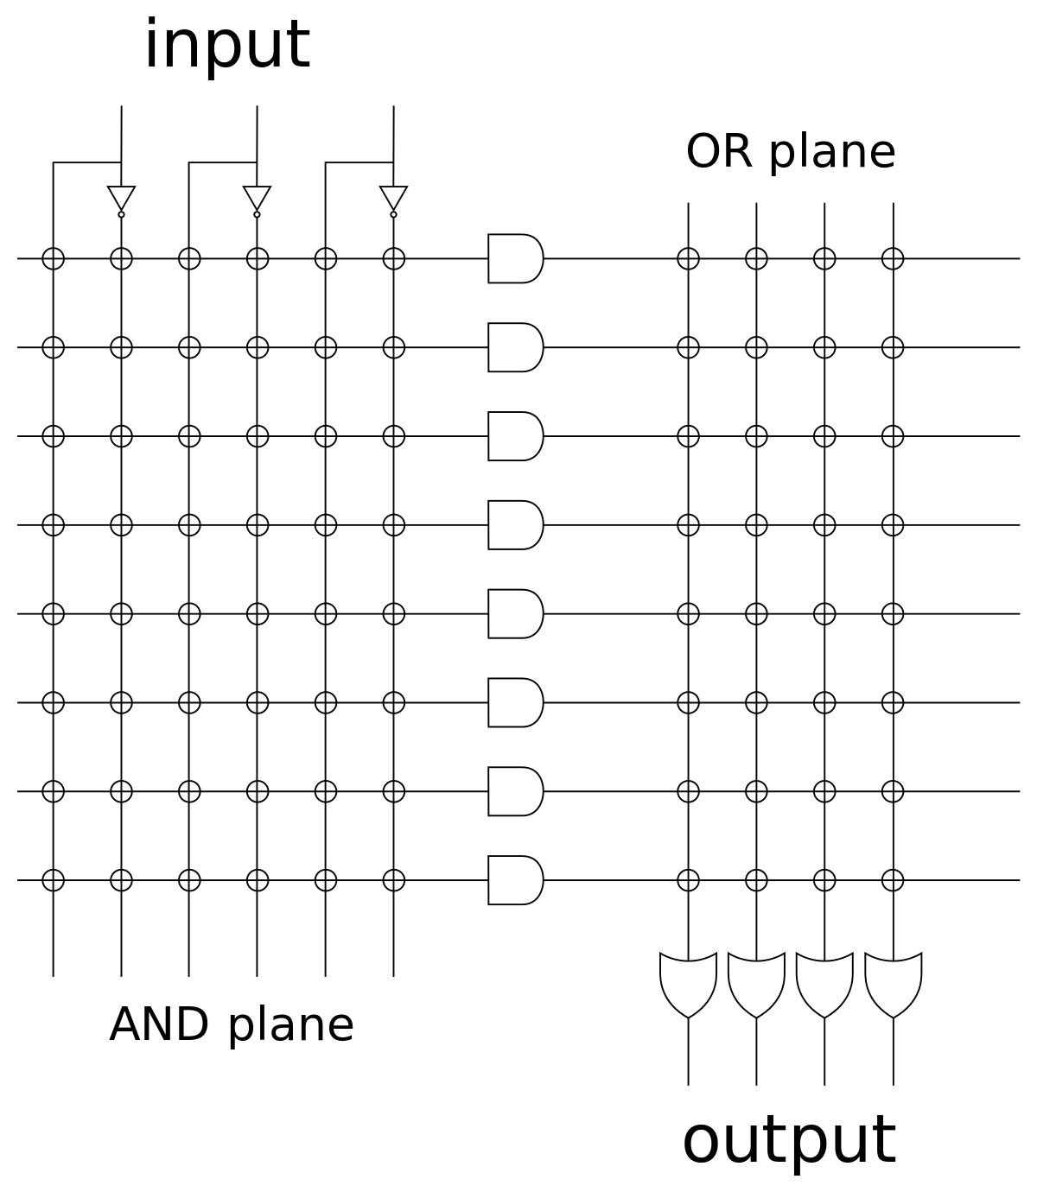
Programmable Logic Devices
Programmable Logic Array (PLA)
A relatively small PLD that contains two levels of logic, an AND-plane and an OR-plane, where both levels are programmable

Slide 49
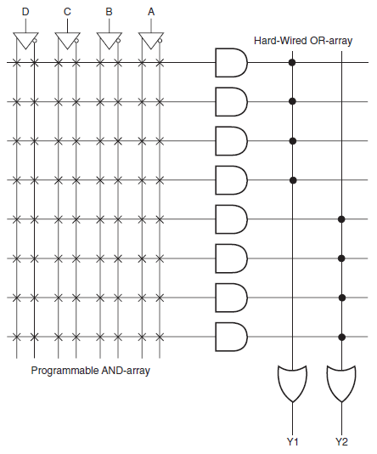
Programmable Logic Devices
Programmable Array Logic (PAL)
A relatively small PLD that has a programmable AND-plane followed by a fixed OR-plane

Slide 50
Programmable Logic Devices
Simple PLD (SPLD)
A PLA or PAL
Complex PLD (CPLD)
A more complex PLD that consists of an arrangement of multiple SPLD-like blocks on a single chip

Slide 51
Programmable Logic Devices
Field-Programmable Gate Array (FPGA)
A general structure that allows very high logic capacity
Whereas CPLDs feature logic resources with a wide number of inputs (AND planes), FPGAs offer more narrow logic resources
FPGAs also offer a higher ratio of flip-flops to logic resources than do CPLDs
Logic Block
A relatively small circuit block that is replicated in an array in an FPD

Slide 52
Programmable Logic Array
Based on fact that any Boolean function can be expressed in SOP
Consists of NOT, AND, and OR gates
Each chip input is NOTed
Output of each AND gate is available to each OR gate
Output of each OR gate is a chip output
Appropriate connects are made to implement a particular SOP expression

Slide 53
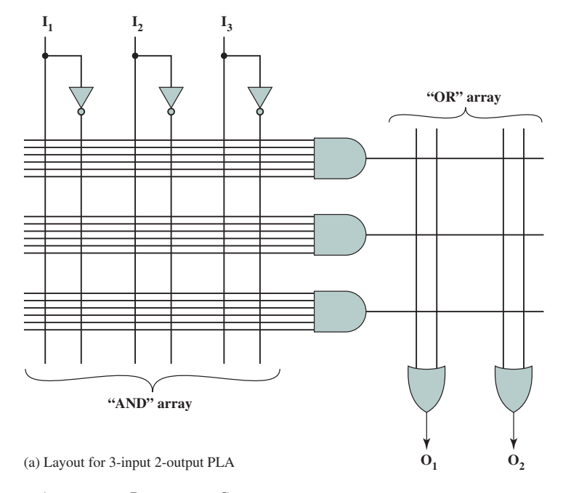
Programmable Logic Array
Notes:
Example of PLA general schema

Slide 54
Programmable Logic Array
PLAs manufactured in 2 ways
Every possible connection is made through a fuse at every intersection
Undesired connections are removed by blowing the fuses
Field Programmable Logic Array
Proper connections made during fabrication
PLAs provide flexible, inexpensive way of implementing digital logic functions

Slide 55
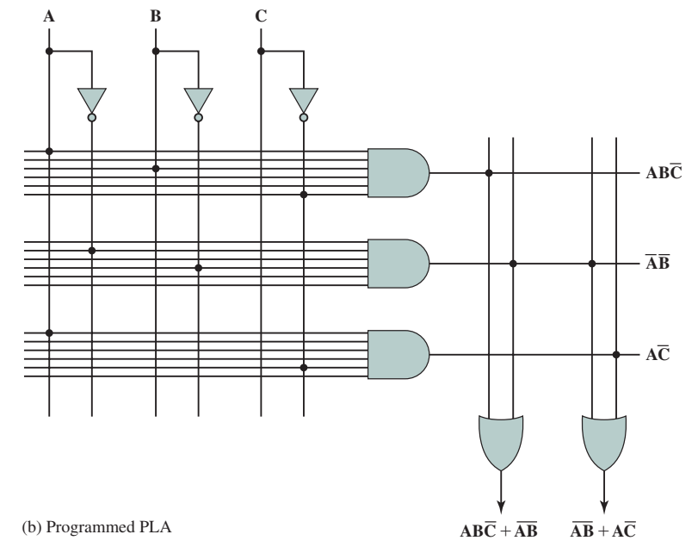
Programmable Logic Array

Slide 56
Field-Programmable Gate Array
PLA is an example of SPLD
Problem is that the structure of programmable logic planes grows too quickly in size as number of inputs increased

Slide 57
Field-Programmable Gate Array
Solution is to integrate multiple SPLD onto single chip
Provide interconnect to programmably connect the SPLD blocks together
Complex PLDs (CPLDs)
Most important type is FPGA

Slide 58
Field-Programmable Gate Array
FPGA consists of an array of uncommitted circuit elements
Key components
Logic block – computation takes place
I/O block – connects I/O pins to circuitry on chip
Interconnect – establish connections among I/O blocks and logic blocks

Slide 59
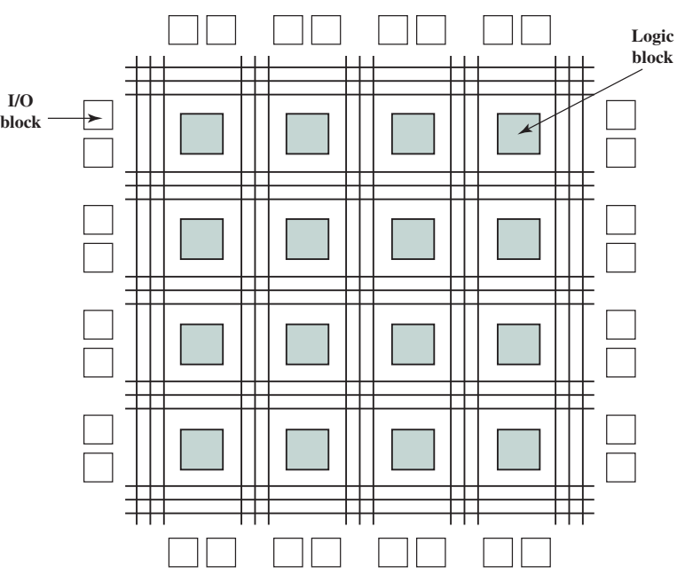
Field-Programmable Gate Array

Slide 60
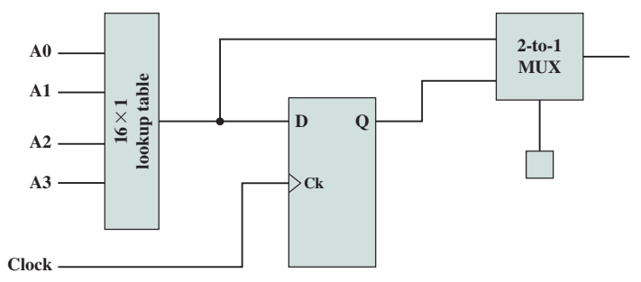
Field-Programmable Gate Array
Logic block is either combinational or sequential circuit
Programming is done by downloading contents of truth table

Slide 61
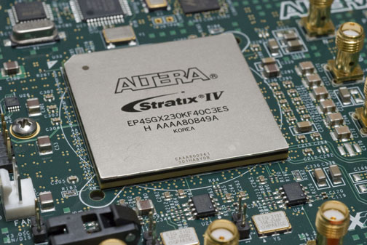
Field-Programmable Gate Array
http://en.wikipedia.org/wiki/Field-programmable_gate_array

Slide 62

Reflection…
From the lecture today,
I learnt…
Link on eLearn / Chat
Image source: https://www.flickr.com/photos/29143375@N05/4582236533

